Slide 1
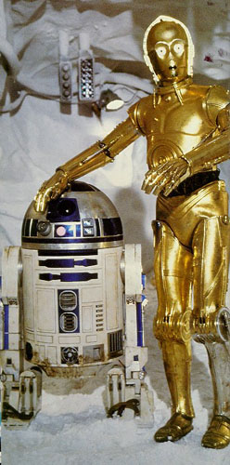
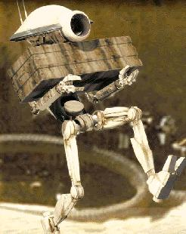
Artificial Intelligent (AI)
Chapter one :- Introduction

Slide 2
Chapter Objectives
Define intelligence
Define AI
Describe what an agent is
State what rational agent is
Identifying areas and achievements of AI
Explain AI history and trends

Slide 3
Data, information, knowledge and wisdom
According to Russell Ackoff, the content of the human mind can be classified into five categories:
Data: Unorganized and unprocessed facts; static; a set of discrete facts about events
Information: Aggregation of data that makes decision making easier
Knowledge is derived from information in the same way information is derived from data; it is a person’s range of information.
Understanding: appreciation of "why“
Wisdom: evaluated understanding
Notes:
Note the level becomes more abstract as we go from data, to information, and to knowledge.
It is the knowledge that we have that enables us to make decisions.

Slide 4
Data
it simply exists and has no significance beyond its existence
It can exist in any form, usable or not
It does not have meaning by itself
A spreadsheet generally starts out by holding data
Information
Is data that has been given meaning by way of relational connection
This "meaning" can be useful, but does not have to be
A relational database makes information from the data stored within it

Slide 5
Knowledge
Knowledge includes facts about the real world entities and the relationship between them.
It is an Understanding gained through experience.
familiarity with the way to perform a task
an accumulation of facts, procedural rules, or heuristics
Characteristics of Knowledge:
It is voluminous in nature and requires proper structuring.
It may be incomplete and imprecise.
It may keep on changing (dynamic).

Slide 6
Understanding
is a true cognitive and analytical ability
Understanding is an interpolative/estimate the value and probabilistic process
Synthesize new knowledge from the previously held knowledge

Slide 7
Wisdom
Is an extrapolative and non-deterministic, non probabilistic process
It calls upon all the previous levels of consciousness, and specifically upon special types of human programming (moral, ethical codes, etc.).
Most people believe that computers do not have, and will never have the ability to posses wisdom.
The following diagram represents the transitions from data, to information, to knowledge, and finally to wisdom. It is called as knowledge hierarchy
Notes:
"A process is deterministic if its present behaviour is only dependent on what happened in the past"

Slide 8
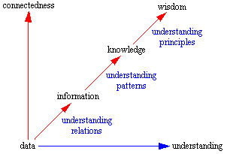
Knowledge Hierarchy

Slide 9
The first four categories relate to the past.
Only the fifth category, wisdom, deals with the future because it incorporates vision and design.
With wisdom, people can create the future rather than just grasp the present and past.
But achieving wisdom isn't easy.
People must move successively through the other categories.
The most important is, it is very hard to represent wisdom with a computer system

Slide 10
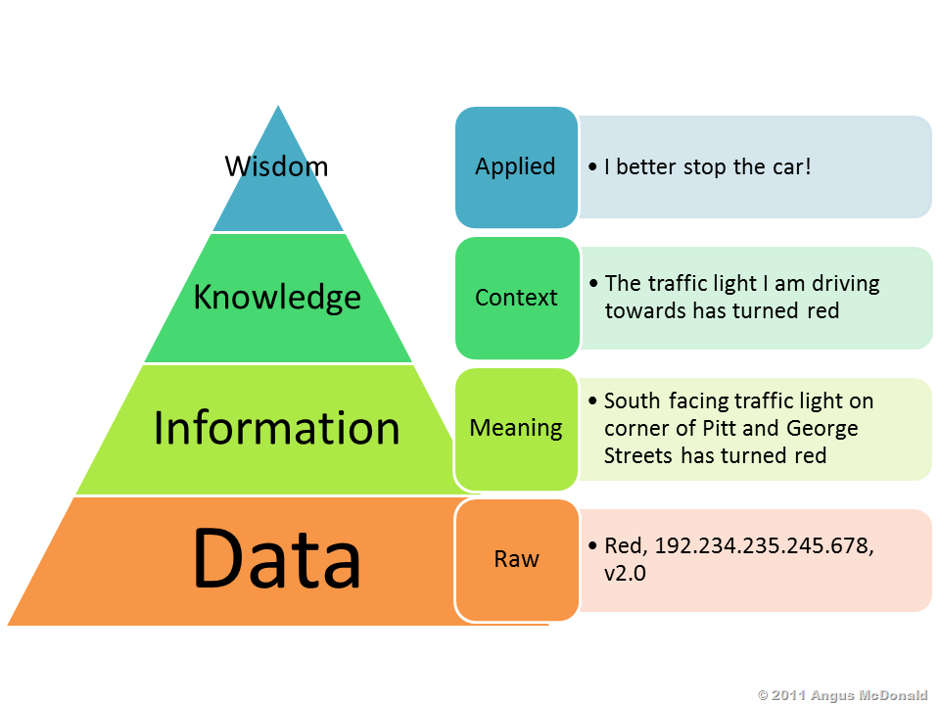

Slide 11
Types (Categorization) of Knowledge
Shallow (readily recalled) and deep (acquired through years of experience)
necessary to make decision/solve problem in complex situations
Procedural (repetitive, stepwise) versus Episodically (grouped by episodes or cases)
Explicit (already represented/documented) and tacit (embedded in the mind)
Up to 95% of information is preserved as tacit knowledge
Notes:
Shallow :-recalled Without much difficulty

Slide 12
Explicit and Tacit Knowledge
Explicit (knowing-that) knowledge:
knowledge codified and digitized in books, documents, reports, memos, etc.
Tacit (knowing-how) knowledge:
knowledge embedded in the human mind through experience and jobs

Slide 13
Intelligence
Intelligence is the capability of observing, learning, remembering and reasoning.
Intelligence is a general mental capability that involves the ability to reason, plan, solve problems, think abstractly, comprehend ideas and language, and learn.
Intelligence draws on a variety of mental processes, including memory, learning, perception, decision-making, thinking, and reasoning.
Memory of Intelligent system is used to store knowledge base which is the key for success for artificial intelligent systems.
Natural Intelligence Versus Artificial Intelligence(?)
Notes:
comprehend :- Get the meaning of something

Slide 14
Characteristics of Intelligent system
Use vast amount of knowledge.
Learn from experience and adopt to changing environment
Interact with human using language and speech
Respond in real time

Slide 15
Human Intelligence
How do people Reason?
They create categories
They use specific rules
– if ‘a’ then ’b’
if ‘b’ then ‘c’
a → b → c
They use Heuristics(commonsense) - “Rule of thumb”
They use Past Experience – “CASES”
- Similarities of current and previous case
- Store cases using key attributes
They Use “Expectations”
How does our brain work when we solve a problem?
Do we think it over and suddenly find an answer?
What do we do when solving a complicated factorization problem, a puzzle or a mystery?

Slide 16
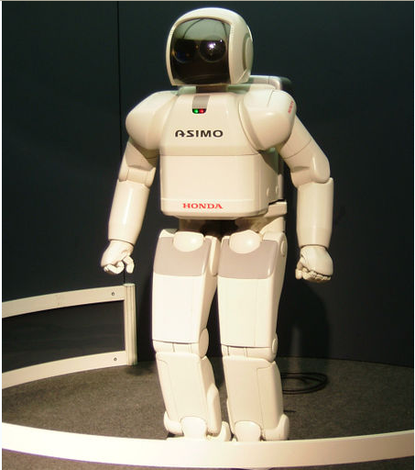
Artificial Intelligence
AI is the branch of Computer Science that deals with ways of:
representing knowledge using symbol rather than numeric value and with rule-of-thumb and method of processing information
AI is the effort to develop computer based system that behave as human.
Such system should be able to learn Natural Language.
Able to do text processing, communicate in natural language and speech
The term AI is first used by John McCarthy (1956) who considers it to mean the science and engineering of making intelligent machine.
Notes:
rule-of-thumb:-a broadly accurate guide or principle, based on practice rather than theory.

Slide 17
Views of AI
AI is found on the premise that:
Workings of human mind can be explained in terms of computation, and
Computers can do the right thing given correct premises and reasoning rules.
Views of AI fall into four categories:
Thinking humanly | Thinking rationally
Acting humanly | Acting rationally

Slide 18
Views of defining AI
What is AI (Artificial Intelligence)
Different scholars define AI differently
(A) AI as a system that think humanly
(B) AI as a system that think rationally
Concerned with thought processing and reasoning
Concerned with behaviors of agents
(C) AI as a system that Act humanly
(D) AI as a system that Act rationally

Slide 19
Views of defining AI
Measures success of AI in terms of human being performance
(A) AI as a system that think humanly
(C) AI as a system that Act humanly
Measures success of AI in terms of ideal concept of intelligence (rationality/logic)
(B) AI as a system that think rationally
(D) AI as a system that Act rationally

Slide 20
Thinking humanly: The Cognitive Modeling
Reasons like humans do
Programs that behave like humans
Requires understanding of the internal activities of the brain
see how humans behave in certain situations and see if you could make computers behave in that same way.
The human thinking process is difficult to understand.
Think also about unconscious tasks such as vision and speech understanding, reflex action
Humans are not perfect ! We make a lot of systemic mistakes
Example. write a program that plays chess.
Instead of making the best possible chess-playing program, you would make one that play chess like people do.
Notes:
The meaning of COGNITIVE is of, relating to, being, or involving conscious intellectual activity (such as thinking, reasoning, or remembering)

Slide 21
Acting humanly: The Turing Test
Can machines act like human do? Can machines behave intelligently?
Turing Test: Operational test for intelligent behavior
Test to determine form of entity: a test in AI in which a human interrogator attempts to determine whether an unseen entity is human or a computer
Acting like humans requires AI programs to interact with people
do experiments on the ability to achieve human-level performance.
Active areas of research to achieve this: Machine learning, NLP, Computer vision, etc
Notes:
interrogator :-A questioner who is excessively harsh

Slide 22
How to make computers act like humans?
The computer should posses the following components
Natural Language processing (enable computers communicate in human language, English, Amharic, etc .)
Knowledge representation (schemes to store information, both facts and inferences, before and during interrogation)
Automated reasoning (use stored information to answer questions and to draw new conclusions)
Machine learning (adapt to new circumstances and accumulate knowledge)
Computer vision (recognize objects based on patterns in the same way as the human visual system does)
Robotics (produce mechanical device capable of controlled motion; which enable computers to see, hear & take actions)
Is AI equals human intelligence ?

Slide 23
Thinking Rationally: The Laws of Thought
A system is rational if it thinks/does the right thing through correct reasoning.
Aristotle: provided the correct arguments/ thought structures that always gave correct conclusions given correct premises.
All fourth year CS students are in their AI class ; Abubeker is 4th year CS student ; therefore Abubeker is also in his AI class
These Laws of thought governed the operation of the mind and initiated the field of Logic.
Problem:
It is not always possible to model thought as a set of rules
Even when a modeling is available, the complexity of the problem may be too large to allow for a solution.

Slide 24
Acting rationally: The rational agent
Doing the right thing so as to achieve one’s goal, given one’s beliefs.
AI is the study and construction of rational agents (an agent that perceives and acts)
An agent is an entity that perceives and acts.
Rational agent: acts as to achieve the best outcome or, when there is uncertainty, the best expected outcome.
Rational action requires the ability to represent knowledge and reason with it so as to reach good decision.
Learning for better understanding of how the world works

Slide 25
How do AI differ from Human Intelligence
The successful AI systems are neither artificial nor intelligent
The successful AI is based on:
Human expertise
Knowledge
Selected reasoning pattern

Slide 26
The Difference between Human Beings and Artificially Intelligent Systems
Human Brain
Natural device
Self-willed and creative
Basic unit – neuron
Storage device – electrochemical
Low crunching
Advanced detective reasoning
Lower speed
Emotion-driven
Limited volume
Fuzzy logic
Computers
Non-natural device
Limited creativity
Basic unit – RAM
Storage device is electromechanical
High crunching
Elementary detective reasoning
High speed
Non-emotional
Higher volume
Numeric (binary) logic

Slide 27
What can AI do today?(Roles of AI)
A concise answer is difficult, because there are so many activities in so many subfields.
Autonomous planning and scheduling
Game playing(person Garry Kasparov, etc)
Autonomous control
Diagnosis
Logistics Planning
Robotics
Language understanding and problem solving

Slide 28
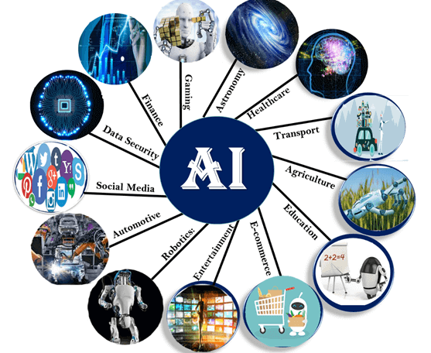
Some Application areas of AI

Slide 29
Applications of AI and KBS contd.
Solving problems that required thinking by humans:
Proving theorems (mathematical theorems, laws of physics, …)
Playing games (chess, checker, cards, ...)
Classification of text (Politics, Economic, sports, etc,)
Writing story and poems; solving puzzles
Giving advice in medicine, law, … (diagnosing diseases, consultation, …)

Slide 30
Programming paradigms
Each programming paradigms consists of two aspects:
Methods for organizing data/knowledge,
Methods for controlling the flow of computation
Traditional paradigms:
Programs = data structure + algorithm
AI programming paradigms:
Programs = knowledge structure + inference mechanism

Slide 31
Problems of AI:
The following points are taken as drawbacks of Artificially Intelligent systems:
AI do not come up with new and novel solutions
Existing AI systems try to reproduce the expertise of humans, but do not behave like human experts
Lack of common-sense
Reasoning: the human intelligence performs better in this respect

